Slide 1
Personal Biometric Feedback and
Direct Communication System
Introducing
BioPod™
Presented by
Meramark Ventures, LLC
Inventors of BioPod™ Technology
© 2018 Meramark Ventures, LLC. All Rights Reserved.
nbn

Slide 2
BioPod® Personal Biometric Feedback and Direct Communication System
BioPod™ Technology Overview
Medical & Emergency Applications including Remote Monitoring of Patients' Vital Signs. Medical professionals are able to communicate directly in realtime with their patients.
BioPod™ Technology is "an exercise and communications system which includes an interactive device wherein the interactive device is configured to gather biometric data; heart rate, oxygen saturation, temperature, end tidal carbon dioxide, etc., relating to a user of the system and transmit this data to a remote device, and the remote device is configured to analyze the data and transmit a response to the interactive device, which in turn communicates the response to the user and additionally communicates with an external device for retrieval of instructions, programs, and data, inter alia. An exercise and communication system facilitates communication between a plurality of users, each having and interactive device and a remote device. The remote device may include a watch, a cell phone, a personal digital assistant, etc.”
The BioPod™ Technology "external device may include an information provider, a service-based center, a counselor, an advisor, a coach, a medical professional, an emergency response center, an information database, a personal computing system, a central computing system, a distributed computing system, a server, a communication exchange system, a global navigation satellite system, an entertainment system, a video game console, streaming media player, etc., cloud based entertainment and content stored in data centers, or any intermediary connecting to or between one or more such points."
*BioPod™ Technology is a U.S. patented wearable sensor system mounted in the user's ear which provides feedback for exercise and healthcare users through a direct communication system and GPS functions which allows coaches, trainers, doctors, nurses, emergency medical professionals, etc., to communicate directly with their patients or athletes. The BioPod™ ear sensors, along with other associated sensors (worn or implanted) and communication system, make it possible to remotely monitor biometric vital signs including Heart Rate, Temperature, Oxygen Saturation, and End Tidal CO2. Feedback can be accessed continuously or intermittently with 24/7/365 direct communications available between the user(s) and a wide range of affiliates"
© 2018 Meramark Ventures, LLC. All Rights Reserved.

Slide 3
BioPod™ Technology
Unique Patented Features
• Remote Patient and Athlete Monitoring • Secure Direct Communications with Healthcare Professionals, Caregivers, Family, Coaches, Trainers and more. • Data collected from ear sensors and other associated sensors includes: Heart Rate, Temperature, Oxygen Saturation, and End Tidal Co2. • Data can be accessed continuously or intermittently with 24/7/365 direct communications available between users and a wide range of affiliates. • Audio Alerts and Haptic Feedback-enabled for real-time notifications for crucial communications such as prescription reminders, remote physical therapy and training data alerts and much more!

Slide 4
BioPod™ Personal Biometric Feedback and Direct Communication System
BioPod™ Technology
Key Benefits for Healthcare/Homecare
What BioPod™ Technology means to Healthcare / Homecare
Medical & Emergency Applications including Remote Monitoring of Patients' Vital Signs. Medical professionals are able to communicate directly in realtime with their patients.
Your CareUniverse Network can securely monitor your vital data and progress in realtime.
Faster response in critical situations
Quicker Key Vital Data
Medical & Emergency Applications including Remote Monitoring of Patients' Vital Signs. Medical professionals are able to communicate directly in real-time with their patients.
Secure Communications between all coordinated healthcare professionals and services
Prescription monitoring and reminders
BioPod™ may add value to a proprietary "specially designed system" which offers 24/7 monitoring of a patient's vital signs, on an intermittent or continuous basis, while offering direct communications to the patient and various authorized contacts within the network, including physicians, nurses, emergency contact applications, and potentially offering direct contact with family members, etc. The ability to integrate BioPod™ Technology into best practices for clinical trials provides an extra advantage to pharmaceutical companies and research entities that count on daily data to refine and perfect their products and discoveries.
IoMT Market Poised To Reach $72 billion by 2021
What this technology can mean to the health and wellbeing of families is truly life changing. One of the chief concerns that faces each family today is being informed of the health of family members who, for any number of reasons, can't easily be checked and monitored. Families with elderly members, family members with disabilities, family members with any number of conditions that can cause concern and excessive worry, may all benefit from the ability to know how loved ones are at any moment in time. BioPod™ technology provides the possibility of creating a network with you and healthcare professionals to deliver the best care available.
Healthcare Providers and Insurers also benefit directly from the possibilities that the BioPod™ technology presents. Healthcare Insurers may be given a platform that allows them to more accurately and efficiently provide coverage for their customers, all at a lower cost for the insurers with the added benefit of being able to reduce premiums for their customers. Healthcare Providers may be provided with real-time feedback that allows them to provide better care for their patients and also make their practices run more efficiently and help them reduce their own operating costs and insurance premiums.
Home patients can be "coached" by their physical therapy, respiratory therapy, and pharmacy professionals while being "coached up" by remote professionals intending to help the patients recuperate, get better, while avoiding return visits to the ER or hospital.
BioPod keeps you connected 24/7/365 with:
Family, Primary Care Physician, Emergency Services, LifeFlight and EVAC, Specialized Medicine, Emergency Response Teams, Independent Labs, Home Healthcare Professionals and all Coordinated Healthcare Professionals.
© 2018 Meramark Ventures, LLC. All Rights Reserved.

Slide 5
BioPod™ Personal Biometric Feedback and Direct Communication System
BioPod™ Technology
What BioPod™ Technology means to Fitness & Sports
Key Benefits for Fitness & Sports
Medical & Emergency Applications including Remote Monitoring of Patients' Vital Signs. Medical professionals are able to communicate directly in realtime with their patients.
Monitor Vitals and Training Performance remotely
Audio and Haptic alerts for Peak performance
Ultimate Remote Direct Biofeedback and Communications Capabilities for Coaches and Trainers with their Athletes and Clients
24/7/365 Data Delivery available continuously or intermittently
Secure Remote Communication available between coaches, trainers and athletes
Training, Performance and Vitals Monitoring Anywhere, Anytime
Training and Altitude Simulations
Heart Rate, Temperature, Oxygen Saturation and Expressed CO² Monitoring
Proprietary to BioPod™Technology, Coaches and trainers would be able to communicate directly with the athlete or to a specific group of individuals to reinforce and to encourage their athletes while the "trainer" monitors their vital signs and training zone performances. GPS support may be provided as would all of the data collection from vital signs to e.g. time, distance, calorie consumption, speed, calculated VO2 Max Value, workload strength, etc, from the individual or team which would also provide for complete communications capabilities including two-way communications to include cell transmissions for phone and for entertainment, with audio message alerts being preset by the athlete or coach for training zone high and low limits whereby customized training regimen options may be selected by the individual or group, and/or downloaded via our training systems to maximize the training experience. The "coach" can access the program and monitor and change the workout to make it harder or easier.
What BioPod™ Technology means for professional trainers and their clients. BioPod™ would provide a system for certified athletic trainers to monitor and to communicate directly with clients while training in a H&F Club or while they are in their homes. Patrons of Health Clubs, individuals, primarily women and older people who choose not to go "on display" at the fitness club, who would prefer to work out in the privacy of their homes but would appreciate the value of their professional trainers having the ability to monitor remotely their personalized workouts while offering reinforcements and encouragement thereby helping them to manage and to maximize their training sessions, would create a new business development opportunity for BioPod™ partners
Full Integration with BioPod™ ProActive Performance Masks
© 2018 Meramark Ventures, LLC. All Rights Reserved.

Slide 6
BioPod™ Personal Biometric Feedback and Direct Communication System
BioPod™ Technology
Key Benefits for Big Data
What BioPod™ Technology means to Big Data
Medical & Emergency Applications including Remote Monitoring of Patients' Vital Signs. Medical professionals are able to communicate directly in realtime with their patients.
Target Advertising through Data Collection
Enhanced Deep Learning
Human Factoring and GPS Location Data
Interest-based Social Media Platform
Haptic and Audio Alerts for Commerce Proximity
Direct to Consumer Marketing & Advertising Programming (Patent-Pending)
BioPod's Big Data Network becomes a refined data source for AI, and AR applications, where the BioPod earbud w/ GPS and communications features eventually becomes a ubiquitous, but valuable component to collect human factors and location data leading to AI applications. With the personalized deep learning capabilities provided by GPS location coupled with personalized biometrics, BioPod will become an effective "method for targeting advertising" while also becoming a "method for interest-based social networking" which is offered in the current BioPod Divisional Patent Application.
"Additionally, "special offers" may be directed to the user from suppliers and/or retailers either in a retail store environment while the user is shopping, or shopping alerts offered by web sites, or relating to the activity-type selected by the user, and possibly leading to connectivity to social networks for walkers, runners, cyclists or other relevant groups to learn about events, blog connections, and special offers," etc.
BIG
DATA
© 2018 Meramark Ventures, LLC. All Rights Reserved.

Slide 7
BioPod™ Personal Biometric Feedback and Direct Communication System
BioPod™ Technology
Key Benefits for Smart Home/ IoT
What BioPod™ Technology means to Smart Home/IoT
Medical & Emergency Applications including Remote Monitoring of Patients' Vital Signs. Medical professionals are able to communicate directly in realtime with their patients.
Audio Communication and Command between User and Smart Devices within Home
Smart Device “Health” Monitoring
Secure Communications between External Personal Network and BioPod User
Potential Integration and Licensing with Current Smart Home Entertainment Devices
The BioPod™ Hearable Home and Beyond
Smart Home information and communication system would be enhanced with the addition of biometrics feedback from all individuals (and even pets) in the Smart Home Control where BioPod’s Hearable Platform
Technology would add value and differentiation to “Home” and may become the conduit for numerous mixed reality and IoTS applications.
BioPod Home Systems provides direct connectivity between the medical professional, healthcare systems, including rehabilitation services along with mixed reality applications.
BioPod’s Platform Biometric Feedback which sources data from our proprietary “earbud” sourcing and communication system could be utilized to be incorporated to enhance leaders in the Smart Home Control providers with upgrades to their existing systems or by providing a “home hospital suite” where BioPod with our proposed “pod” docking station would be the technical support module for the home care patients.
© 2018 Meramark Ventures, LLC. All Rights Reserved.

Slide 8
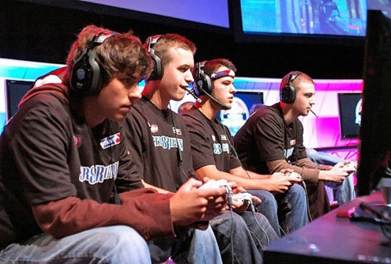
BioPod™ Personal Biometric Feedback and Direct Communication System
BioPod™ Technology
What BioPod™ Technology means to Video Gaming
Key Benefits for Video Gaming
Medical & Emergency Applications including Remote Monitoring of Patients' Vital Signs. Medical professionals are able to communicate directly in realtime with their patients.
Communication of Biometric Feedback possible between team members or adversaries
Creates New Levels of Challenge with smart game platform that “learns and adapts” to player biometric feedback
BioPod™ Biometric Feedback for Enhanced Real-Time Communication and Competition for Gamers
Game-Changing, Paradigm-Changing Possibilities
Enhanced Supercharged Gaming Experience
BioPod™Technology may add a proprietary distinction and value proposition to the video game industry where direct communications and monitoring of gamer’s vitals adds an infinite number of game play possibilities where the game becomes reactive and dynamic in response to the data collected by BioPod™ Technology. This reactive component creates the ability for future gaming architecture to be fluid and provide an ever-changing gaming environment which extends the interest and playability of each game that incorporates BioPod™Technology into their programming architecture. Imagine a game that could change course simply based on the changing data from each user. This addition to options within a game provides powerful exponential possibilities to the challenges available in game play. Another additional possibility would be that a gamer’s vitals could be displayed within the game to ramp up the challenge between competing gamers. BioPod™ Technology provides a direct communications link between gamers and enthusiasts with "The BioPod™ Technology Community" through real-time encouragement and responses to individual and team players.
BioPod™ Technology Added Value improves "Motion Sensing" calculations while using "actual biomedical feedback for heart-rate, oxygen saturation, respiration, temperature, end-tidal CO2, etc., all with direct communications to the individual, those connected to the network, and the game itself. By offering a major point-of-differentiation over the existing algorithms, BioPod™ Technology offers the potential to make a quantum leap in video game development. As a prominent video gaming industry executive and consultant recently stated, he "sees the value and importance of accurate and consistent measurement of biorhythms for enhanced game play and fitness performance".
© 2018 Meramark Ventures, LLC. All Rights Reserved.

Slide 10
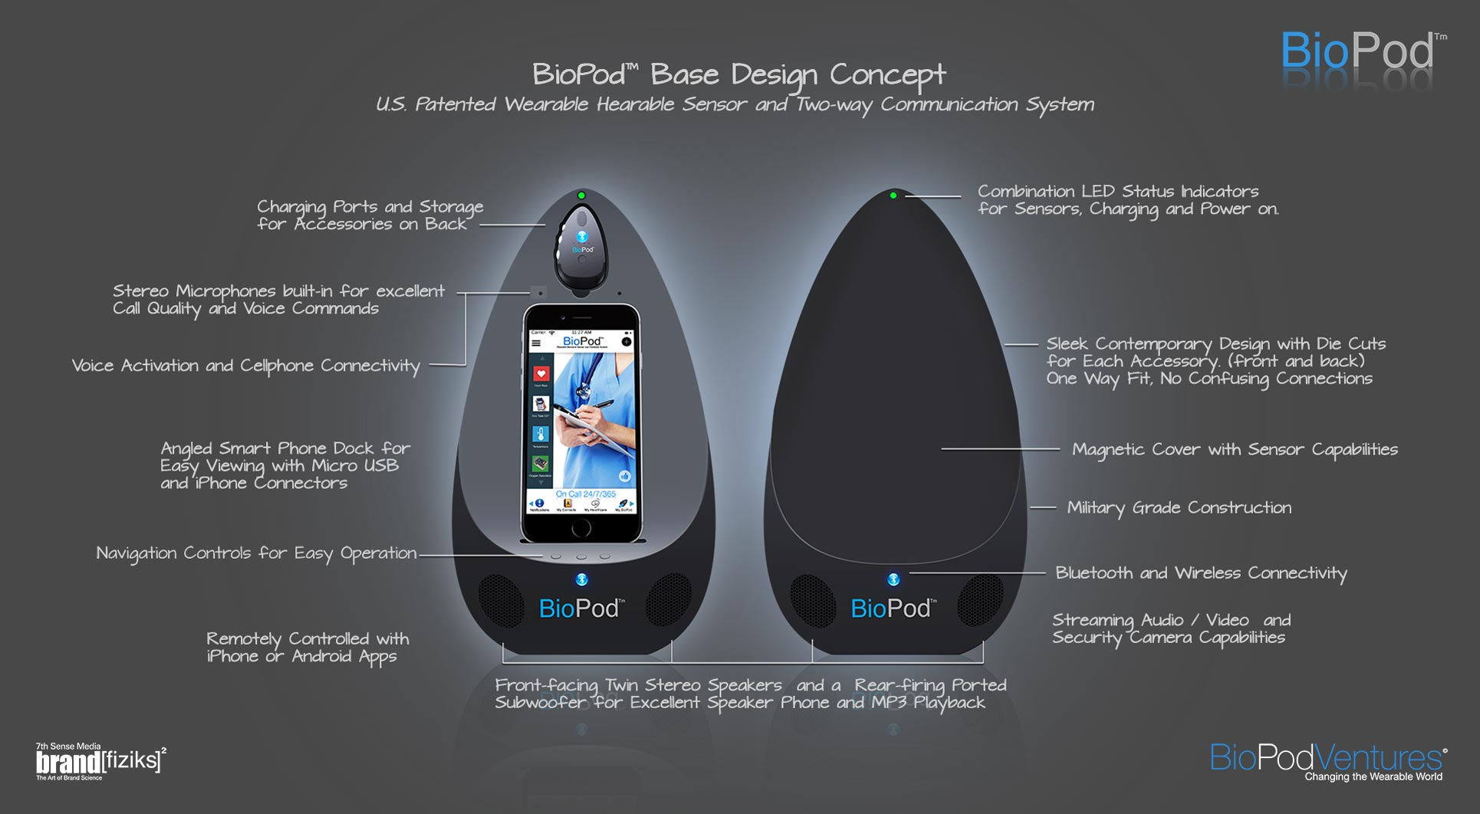

Slide 11
Contact
FOR MORE INFO, CONTACT
Website, Media and Patent Links
BioPodTech.com
BioPod Ventures
USPTO Issued Patents
BioPod™ Print Brochure
BioPod® is a Registered Trademark of Meramark Ventures LLC
• Biometric feedback systems for collecting, transmitting, sharing and displaying biometric data
• Sensors for medical use to be worn by or implanted in humans
• Goods having applications in the fields of health, exercise, education and entertainment
© 2018 Meramark Ventures, LLC. All Rights Reserved.

